Slide 1
Supervised Learning: Regression and Classification

Slide 2

Describe supervised learning and its types
Summarize the flow of supervised learning
Analyze the supervised learning use cases
List the various types of classification algorithms

Slide 3
Supervised Learning: Overview

Slide 4

Supervised Learning
Supervised learning is used to train models using labeled training data. It provides the ability to predict the output of future or unseen data.
The goal of a supervised learning algorithm is to discover a mapping function that will translate the input variable (x) to the output variable (y).
Notes:
https://www.shutterstock.com/image-vector/flat-line-design-website-banner-learning-389760973

Slide 5



Supervised Learning
If the shape of the object is rounded having a red color, then it will be labeled as an Apple
Supervised learning algorithm
If the shape of the object is a curving cylinder having the color green-yellow then it will be labeled a banana

Slide 6
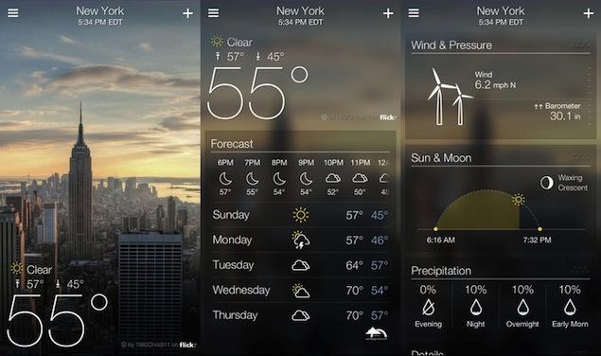
Supervised Learning: Examples
Example 1: Weather Apps
The predictions made by weather apps at a given time are based on prior knowledge and analysis of weather over a period for a particular place.

Slide 7
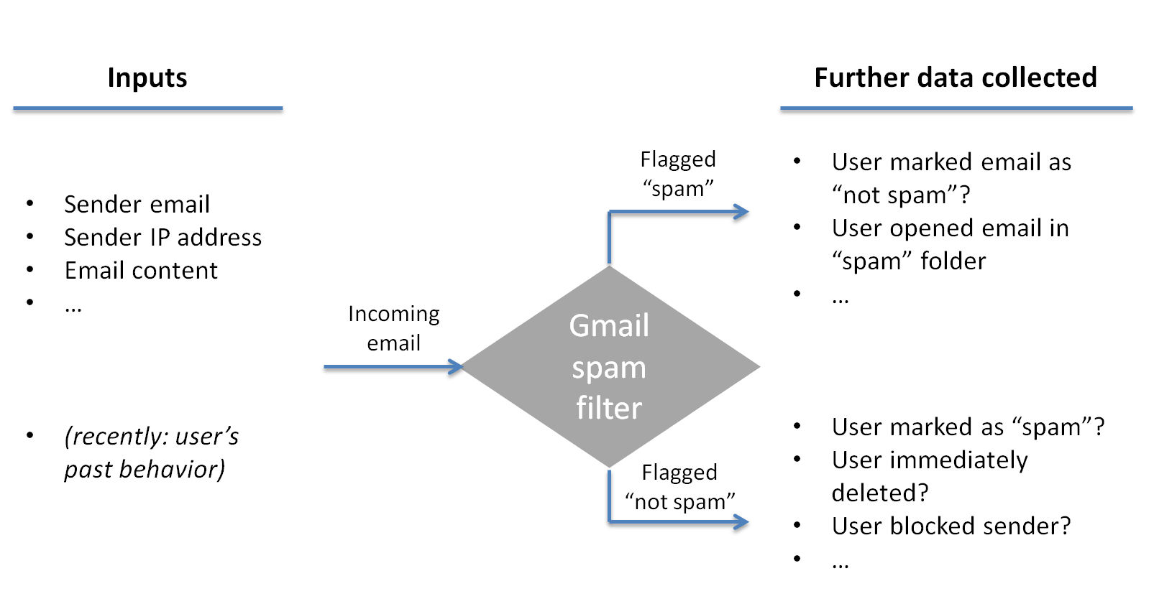
Supervised Learning: Examples
Example 2: Gmail filters
It helps to filter a new email into an inbox (normal) or junk folder (Spam) based on past information of spam.

Slide 8

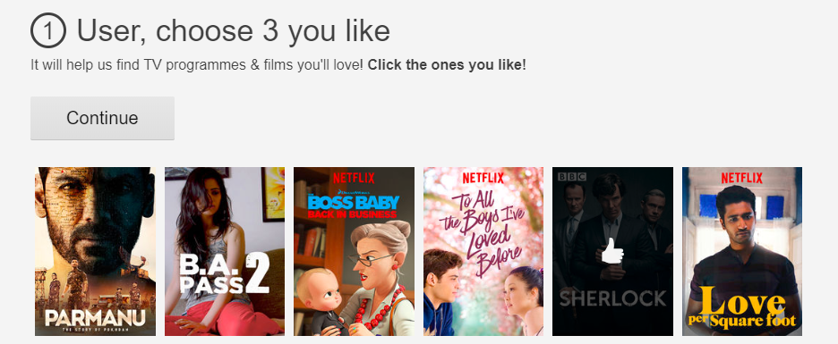
Netflix: Real-Life Scenario
Ever wondered how Netflix makes recommendations?

Slide 9

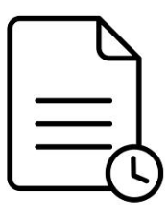
Netflix: Real-Life Scenario
Netflix uses supervised learning algorithms to recommend shows for the users based on the viewing history and ratings by similar classes of users.
New input
Predicted outcome
Algorithms trained on historical data

Slide 10
Understanding the Algorithm
Input
Output (Labels)
x1
y1
Train the algorithm (reverse-engineer the relationship between x and y)
x2
y2
x3
y3
Learned algorithm
x4
y4
x5
y5
y = f(x)
(y is some function of x)
Training data
x6
y6
x7
y7
Predict y for the new instance x_{new} using y = f(x)
x8
y8
x9
y9
x10
y10

Slide 11




Supervised Learning: Process Flow
Training and Testing
70%
Training
dataset
Machine
learning
Statistical
model
Historical
data
Random sampling
Prediction
30%
Test dataset
Prediction and testing
Model validation outcome

Slide 12


Supervised Learning: Process Flow
Use the learned algorithm y = f(x) to predict production data
Training and testing
New data
Model
Prediction outcome
Prediction
Algorithm prediction can be improved by more training data, capacity, or algorithm redesign.

Slide 13
Types of Supervised Learning

Slide 14
Types of Supervised Learning
1
Supervised Learning
2
Classification
Regression
In supervised learning, an algorithm is selected based on the target variable.

Slide 15
Regression Algorithms

Slide 16
Regression
Regression is a statistical model used to predict the relationship between independent and dependent variables denoted by x and y respectively
Examine 2 factors
1
2
How closely are x and y related?
Linear regression gives a number between -1 and 1 indicating the strength of correlation between the two variables
0: no correlation
1: positively correlated
-1: negatively correlated
Prediction
When the relationship between x and y is known, use this to predict future values of y for a value of x. This is done by fitting a regression line and represented by a linear equation
y = a * x + b

Slide 17

Types of Regression Algorithms
Linear
Multiple Linear
Ridge
Lasso
Polynomial
ElasticNet

Slide 18




Regression: Use Case
Predicting profit based on expenditures of the company
2
Administration
1
R&D Spend
3
Profit Estimation
Marketing Spend
5
Profit
4
State

Slide 19
Classification Algorithms

Slide 20
Classification
Acme Article
Acme Article
Acme Article
Classification is a technique used for determining which class the dependent variable belongs to based on one or more independent variables.
It is mainly used for predicting discrete values.
Technology
Acme Article
Food Article
Food Article
Food Article
Sports
Bar Article
Bar Article
Bar Article
Entertainment
Notes:
Trainer notes:
Consider an Acme article, using classification technique the article is classified into three categories such as technology, sports, and entertainment.

Slide 21
Classification: A Supervised Learning Algorithm
Classification is a supervised learning algorithm, and the training data contains labels.
Record ID | Age | Spectacle Prescription | Astigmatic | Tear production Rate | Class Label Lenses
1 | Young | Myope | No | Reduced | Noncontact
2 | Young | Myope | No | Normal | Soft contact
3 | Young | Myope | Yes | Reduced | Noncontact
4 | Young | Myope | Yes | Normal | Hard contact
5 | Young | Hypermetrope | No | Reduced | Noncontact
6 | Young | Hypermetrope | No | Normal | Soft contact
7 | Young | Hypermetrope | Yes | Reduced | Noncontact
8 | Young | Hypermetrope | Yes | Normal | Hard contact
9 | Pre-presbyopic | Myope | No | Reduced | Noncontact
10 | Pre-presbyopic | Myope | No | Normal | Soft contact
11 | Pre-presbyopic | Myope | Yes | Reduced | Noncontact
12 | Pre-presbyopic | Myope | Yes | Normal | Hard contact
13 | Pre-presbyopic | Hypermetrope | No | Reduced | Noncontact
14 | Pre-presbyopic | Hypermetrope | No | Normal | Soft contact
15 | Pre-presbyopic | Hypermetrope | Yes | Reduced | Noncontact
16 | Pre-presbyopic | Hypermetrope | Yes | Normal | Noncontact
17 | Presbyopic | Myope | No | Reduced | Noncontact
18 | Presbyopic | Myope | No | Normal | Noncontact
19 | Presbyopic | Myope | Yes | Reduced | Noncontact
20 | Presbyopic | Myope | Yes | Normal | Hard contact
Supervised Learning Model
Feature
Vectors
Training Text,
Documents,
Images, etc.
Labels
Machine
Learning
Algorithm
Feature
Vectors
New Text,
Document,
Images, etc.
Predictive
Model
Expected
Label

Slide 22
Types of Classification Algorithms
Types
Logistic Regression
Used to estimate discrete values (binary values like 0/1, yes/no, true/false ) based on given set of independent variable(s)
Decision Trees
Decision Trees make sequential, hierarchical decisions about the outcome variable based on the predictor data
Random Forest
Random Forest is an ensemble of decision trees that gives better prediction and accuracy than decision tree
Naive Bayes Classifier
Based on Bayes theorem and works with an assumption that features are independent
Support Vector Machines
SVM draws hyperplane in a feature space that separates instances into different categories with margins in between as far apart as possible

Slide 23

Classification: Use Case
Sentiment analysis, fraud detection, spam filtering, and product categorization are examples of classification.

Slide 24
Difference between Regression and Classification Outputs

Slide 25
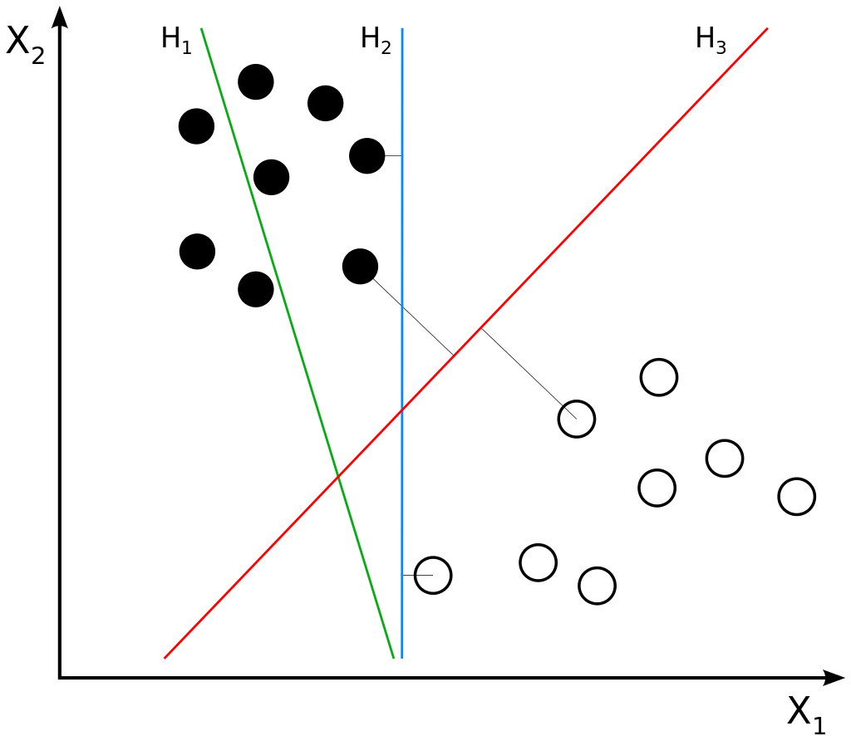

Classification and Regression: Graphs
Classification
It classifies discrete values such as male or female, true or false, and spam or not spam.
It must identify the best fit line that predicts the output more accurately.
Regression
It predicts continuous values like price, wage, and age.
It must identify the best decision boundary that divides the dataset into different classes.

Slide 26
In supervised learning, the program is given labeled input data and expected output results.
Regression is preferred to predict a continuous quantity and classification is preferred to predict a discrete class label.
Regression can be used for profit estimation in different departments such as R & D, administration, and marketing.
In supervised learning, an algorithm is selected based on the target variable.

